Slide 1


“SciCycle: Circular Economy for Lab Supplies”
SciCycle is a platform that promotes sustainable lab practices by connecting sellers and buyers of used lab equipment. We aim to reduce waste and create a more efficient and cost-effective ecosystem for scientific research.

Slide 2
Introduction
1
Problem
2
Solution
Researchers, laboratories, and institutions often struggle to find cost-effective solutions for their equipment needs. Meanwhile, sellers have difficulty reaching potential buyers for surplus or obsolete lab parts.
SciCycle serves as a central platform for sustainable lab practices by collecting, refurbishing, and redistributing used lab equipment. We develop a user-friendly marketplace that connects sellers with buyers, facilitating the reuse, recycling, and repair of lab testing machine parts.

Slide 3

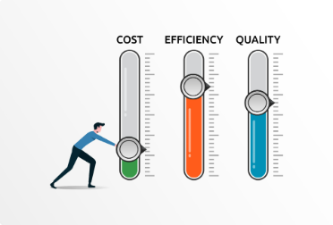
VALUE PROPOSITION
Cost Efficiency
Waste Management
Sellers can monetize unused or surplus parts, while buyers can acquire parts at a lower cost compared to new ones.
Encourage the recycling and repurposing of equipment, reducing environmental impact.
Reduced Carbon Footprint
Sustainability and Energy Savings
Recycling and repurposing equipment reduces the need for manufacturing new products, resulting in lower greenhouse gas emissions and a smaller environmental footprint.
Manufacturing new parts consumes significant amounts of energy. Reusing parts saves energy that would otherwise be used in production processes, helping to reduce carbon emissions.

Slide 4
Key features
User Profiles
Functionality
Additional Features
Separate profiles for sellers and buyers.
Allow sellers to list parts with detailed descriptions, conditions, and photos. Enable buyers to search for parts by type, machine model, condition, etc. Secure payment and order processing system.
Options for transportation arrangements and cost calculation. Enable users to rate transactions and provide feedback. Provide customer support and communication channels.
Product Listings
Search and Filter Options
Transaction Management

Slide 5



TARGET AUDIENCE
Repair Experts and Technicians: Professionals skilled in repairing and refurbishing lab equipment. They can offer repair services through your platform.
Laboratories and Institutions: Labs with surplus or outdated equipment. Institutions aiming to reduce waste and promote sustainability.
Researchers and Scientists: Individuals working in research labs, universities, and private institutions who require lab equipment. Researchers looking for affordable alternatives to new equipment.

Slide 6


BENEFITS FOR SELLERS
Monetary Gain
. Earn money from surplus parts
Clear Space
Free up lab space by selling unused equipment.

Slide 7
BENEFITS FOR BUYERS
Cost Savings
Access lab parts at a fraction of the price.
Access to Discontinued Parts
Find parts that are no longer available from original manufacturers.

